Slide 1

Secure Web Application-SSL

Slide 2
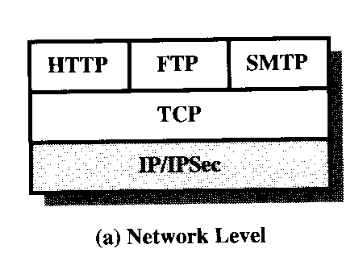
Web Traffic Security Approaches
A number of approaches to provide Web security are possible. The various approaches that have been considered are similar in the services that they provide and, to some extent, in the mechanisms that they use, but they differ with respect to their scope of applicability and their relative location within the TCP/IP protocol stack.
One way to provide Web security is to use IP Security. The advantage of using IPSec is that it is transparent to end users and applications and provides a general-purpose solution. Further, IPSec includes a filtering capability so that only selected traffic need incur the overhead of IPSec processing.

Slide 3
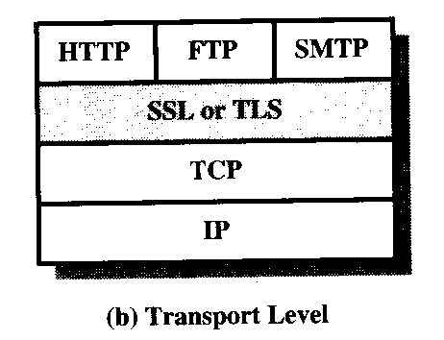
Web Traffic Security Approaches
Another relatively general-purpose solution is to implement security just above TCP. The foremost example of this approach is the Secure Sockets Layer(SSL) and the follow-on Internet standard of SSL known as Transport Layer Security(TLS). At this level, there are two implementation choices. For full generality, SSL (or TLS) could be provided as part of the underlying protocol suite and therefore be transparent to applications. Alternatively, SSL can be embedded in specific packages. For example, Netscape and Microsoft Explore browsers come equipped with SSL, and most Web servers have implemented the protocol.

Slide 4
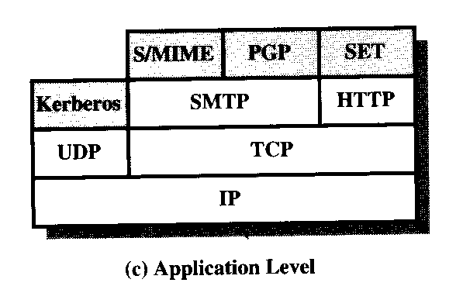
Web Traffic Security Approaches
Application-specific security services are embedded within the particular application. The Figure shows examples of this architecture. The advantage of this approach is that the service can be tailored to the specific needs of a given application.

Slide 5
Secure Socket Layer (SSL)
SSL was originated by Netscape. Version 3 of the protocol was designed with public review and input from industry and was published as an Internet draft document.
SSL is designed to make use of TCP to provide a reliable end-to-end secure service. SSL is not a single protocol but rather two layers of protocols.
The SSL Record Protocol provides basic security services to various higher-layer protocols. In particular, the hypertext transfer protocol (HTTP), which provides the transfer service for Web client/server interaction, can operate on top of SSL.

Slide 6
Secure Socket Layer (SSL)
Three higher-layer protocols are defined as part of SSL: the Handshake Protocol, the Change Cipher Spec Protocol, and the Alert Protocol. These SSL-specific protocols are used in the management of SSL exchangers and are examined later.
Two important SSL concepts are the SSL session and the SSL connection, which are defined in the specification as follows:
1. Connection: A connection is a transport that provides a
suitable type of service. For SSL, such connections are
peer-to-peer relationships. The connections are transient.
Every connection are transient. Every connection is
associated with one session.
2. Session: An SSL session is an association between a client and a
server. Sessions are created by the Handshake Protocol. Sessions
define a set of cryptographic security parameters, which can be shared
among multiple connections. Sessions are used to avoid the expensive
negotiation of new security parameters for each connection.

Slide 7
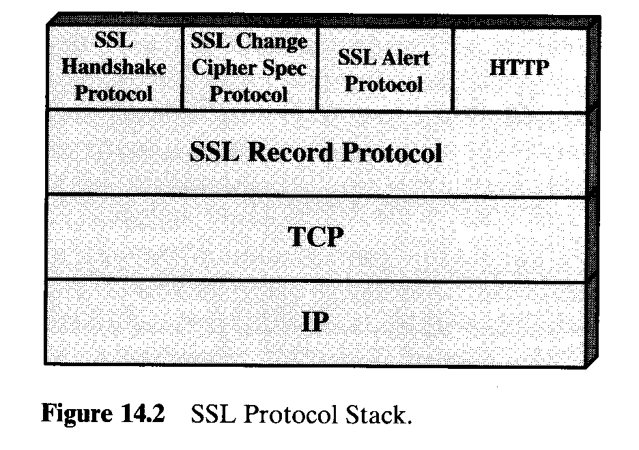
Secure Socket Layer (SSL)

Slide 8
Secure Socket Layer (SSL)
A session state is defined by the following parameters:
1. Session identifier: An arbitrary byte sequence chosen by
the server to identify an active or resumable session
state.
2. Peer certificate: An X509.v3 certificate of the peer. This
element of the state may be null.
3. Compression method: The algorithm used to compress
data prior to encryption.
4. Cipher spec: Specifies the bulk data encryption
algorithm used for MAC calculation.
5. Master secret: Forty-eight-byte secret shared between
the client and server.
6. Is resumable: A flag indicating whether the session can be
used to indicate new connections.

Slide 9
Secure Socket Layer (SSL)
A connection state is defined by the following parameters:
1. Server and client random: Byte sequences that are chosen by
the server and client for each connection.
2. Server write MAC secret: The secret key used in MAC
operations on data sent by the server.
3. Client write MAC secret: The secret key used in MAC
operations on data sent by the client.
4. Server write key: The conventional encryption key for data
encrypted by the server and decrypted by the client.
5. Client write key: The conventional encryption key for data
encrypted by the client and decrypted by the server.
6. Initialization vectors: When a block cipher in CBC mode is
used, an initialization vector(IV) is maintained for each key.
7. Sequence number: Each party maintains separate sequence numbers for transmitted and received messages for each connection.

Slide 10
SSL Record Protocol
The SSL Record Protocol provides two services for SSL connections:
1. Confidentiality: The Handshake Protocol defines a
shared secret key that is used for conventional
encryption of SSL payloads.
2. Message Integrity: The Handshake Protocol defines a
shared secret key that is used to form a message
authentication code (MAC).

Slide 11
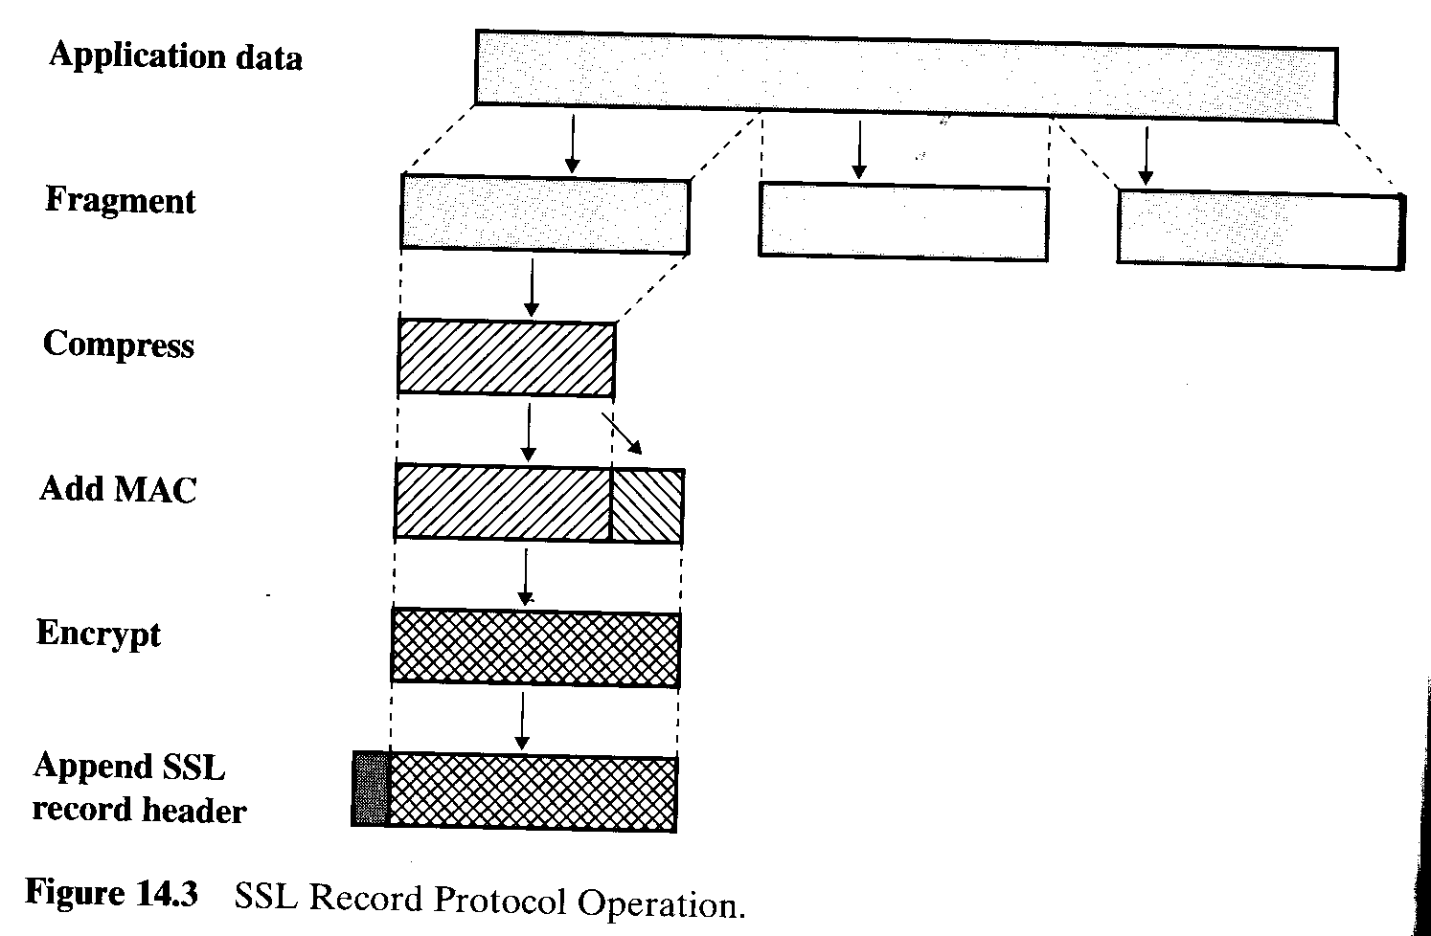
SSL Record Protocol
The Record Protocol takes an application message to be transmitted, fragments the data into manageable blocks, optionally compresses the data, applies a MAC, encrypts, adds a header, and transmits the resulting unit in a TCP segment.

Slide 12
SSL Record Protocol
The first step is fragment. Each upper-layer message is fragmented into blocks of bytes (16384 bytes) or less.
Next, compression is optionally applied. Compression must be lossless and may not increase the content length by more than 1024 bytes.
The next step in processing is to compute a message authentication code over the compressed data. For this purpose, a shared secret key is used. The calculation is defined as following:
hash(MAC_write_secret || pad_2 ||
hash(MAC_write_secret || pad_1 || seq_num || SSLCompressed.type ||
SSLCompressed.length || SSLCopressed.fragment))
|| = concatenation
MAC_write_secret = shared secret key
hash = cryptographic hash algorithm, either MD5 or SHA-1
pad_1 = the byte 0x36 (0011 1100) repeated 48 times for MD5
and 40 times for SHA-1
pad_2 = the byte 0x5C (0101 1100) repeated 48 times for MD5
and 40 times for SHA-1
seq_num = the sequence for this message
SSLCompress.type = the higher-level protocol used to process this fragment
SSLCompressed.length = the length of the compressed fragment
SSLCompress.fragment = the compressed fragment

Slide 13
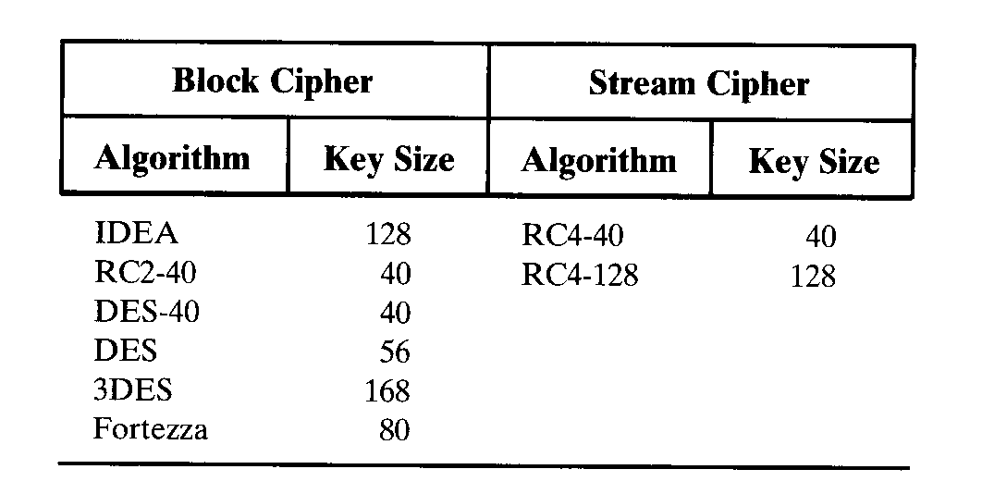
SSL Record Protocol
Next, the compressed message plus the MAC are encrypted using symmetric encryption. Encryption may not increase the content length by more that 1024 bytes, so that the total length may not exceed . The following encryption algorithms are permitted:

Slide 14
SSL Record Protocol
The final step of SSL Record Protocol processing is to prepend a header, consisting of the following fields:
1. Content Type ( 8 bits): The higher-layer
protocol used to process the enclosed fragment.
2. Major Version (8 bits): Indicates major version
of SSL in use. For SSLv3, the value is 3.
3. Minor Version ( 8 bits): Indicates minor version
in use. For SSLv3, the value is 0.
4. Compressed length ( 16 bits): The length in
bytes of the plaintext fragment.

Slide 15
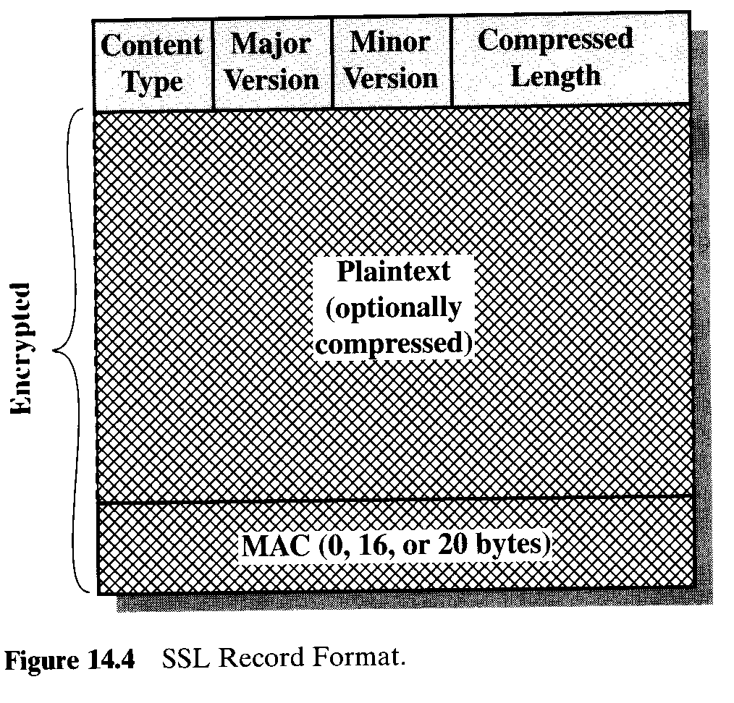
SSL Record Format

Slide 16
Change Cipher Spec Protocol
The Change Cipher Spec Protocol is one of the three SSL-specific protocols that use the SSL Record Protocol, and it is the simplest. This protocol consists of a single message, which consists of a single byte with the value 1. The sole purpose of this message is to cause the pending state to be copied into the current state, which updates the cipher suite to be used on this connection.

Slide 17
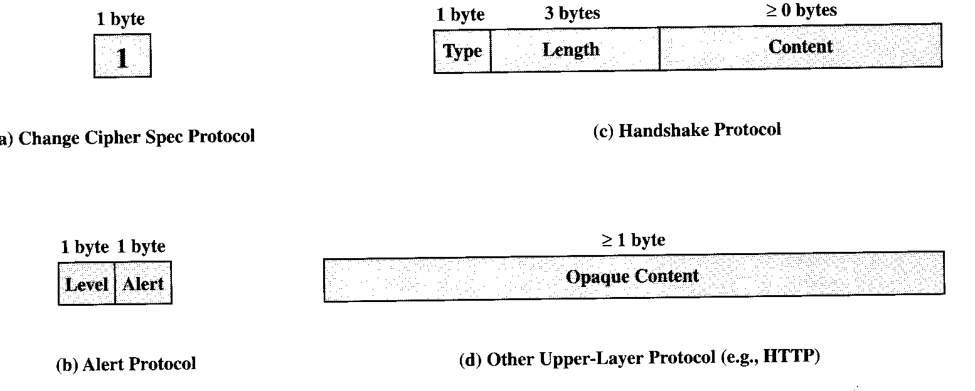
Alert Protocol
Each message in this protocol consists of two bytes. The first byte takes the valve warning(1) or fatal(2) to convey the severity of the message. If the level is fatal, SSL immediately terminates the connections. Other connections on the same session may continue, but no new connections on this session may be established.

Slide 18
Alert Protocol
Fatal Alert:
1. unexpected_message
2. bad_record_mac
3. decompression_failure
4. handshake_failure
5. illegal_parameter
Warning Alert:
1. close_notify
2. no_certificate
3. bad_certificate
4. unsupported_certificate
5. certificate_revoked
6. certificate_expired
7. certificate_unknown

Slide 19
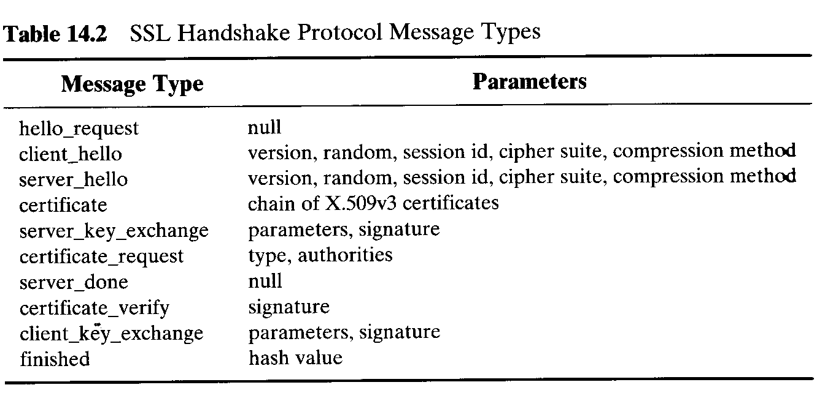
Handshake Protocol
The most complicate part of SSL is the Handshake protocol. This protocol allows the server and client to authenticate each other and to negotiate an encryption and MAC algorithm and cryptographic keys to be used to protect data sent in an SSL record. The handshake protocol is used before any application data transmitted.
Each message has three fields:
1. Type (1 byte): Indicates one of ten messages.
2. Length(3 bytes): The length of the message in bytes.
3. Content( ≥ 1 byte): The parameters associated with this
message.

Slide 20
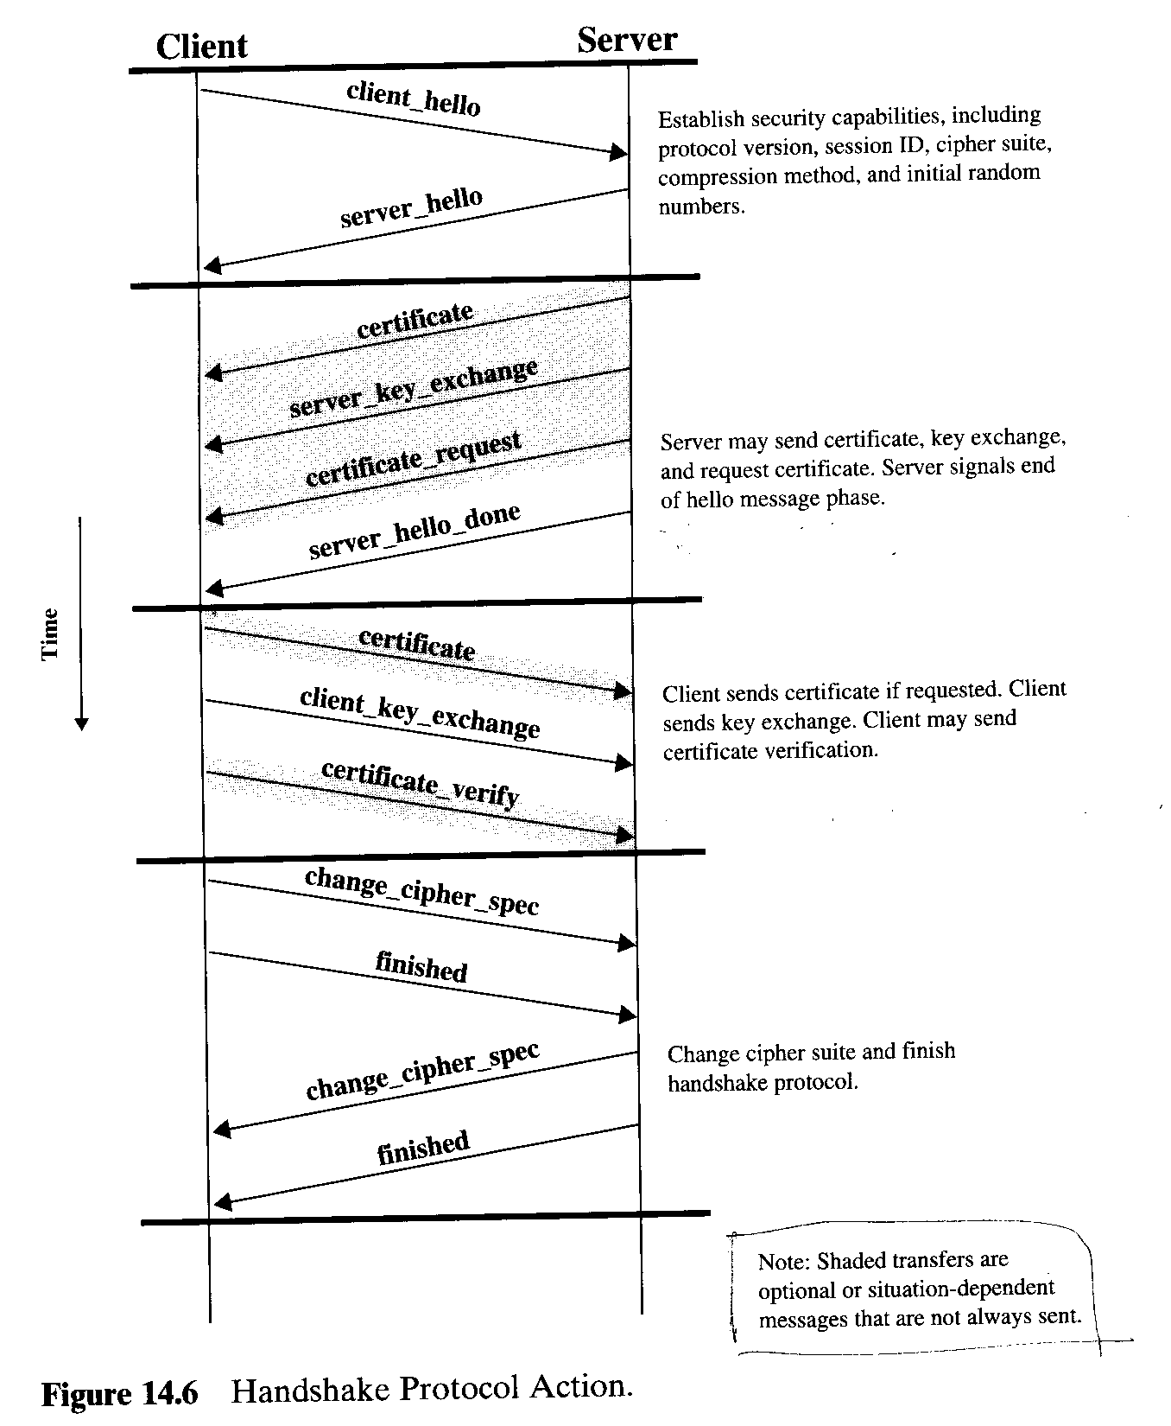
Handshake Protocol

Slide 21
Handshake Protocol
Phase 1. Establish Security Capability
This phase is used to initiate a logical connection and to establish the security capabilities that will be associated with it. The exchange is initiated by the client, which sends a client_hello message with the following parameters:
1. Version: The highest SSL version understood by the
client.
2. Random: A client-generated random structure, consisting of a 32-bit
timestamp and 28 bytes generated by a secure random number
generator.
3. Session ID: A variable-length session identifier.
4. CipherSuit: This is a list that combinations of cryptographic
algorithm supported by the client, in decreasing order of preference.
5. Compression Method: This is a list of the compression methods the
client supports.

Slide 22
Handshake Protocol
After sending the client_hello messages, the client waits for the server_hello message, which contains the same parameters as the client_hello message. For the server_hello message, the following conventions apply. The Version field contains the lowest of the version suggested by the client and the highest supported by the server. The Random field is generated by the server and is independent of the client’s Random field. If the Session ID field of the client was nonzero, the same value is used by the server; otherwise the server’s Session ID field contains the value for a new session. The Cipher Suit field contains the single cipher suite selected by the server from those proposed by the client. The Compression field contains the compression method selected by the server from those proposed by the client.

Slide 23
Handshake Protocol
The first element of the Cipher Suit parameter is the key exchange method. The following key exchange methods are supported:
1. RSA: The secret key is encrypted with the receiver’s RSA public
key. A public-key certificate for the receiver’s key must be made
available.
2. Fixed Diffie-Hellman: This is a Diffie-Hellman key exchange in
which the server’s certificate contains the Diffi-Hellman public
parameters signed by the CA.
3. Ephemeral Diffie-Hellman: This technique is used to create
ephemeral secret keys.
4. Anonymous Diffie-Hellman: The basic Diffie-Hellman algorithm is
used, with no authentication. The approach is vulnerable to man-in-
the-middle attacks, in which attacker conducts anonymous Diffie-
Hellman with both parties.
5. Frotezza: The technique defined for the Fortezza scheme.

Slide 24
Handshake Protocol
Following the definition of a key exchange method is the CipherSpec, which includes the following fields:
1. CipherAlgorithm: Any of the algorithms mentioned
earlier: RC4, RC2, DES, 3DES, DES40, IDEA,
Fortezza.
2. MACAlgorithm: MD5 or SHA-1
3. CipherType: Stream or Block
4. IsExportable: True or False
5. HashSize: 0, 16(for MD5), or 20 ( for SHA-1) bytes
6. Key Material: A sequence of bytes that contain data used in
generating the write keys
7. IV Size: The size of the Initialization Value for Cipher Block
Chaining (CBC) encryption

Slide 25
Handshake Protocol
Phase 2. Server Authentication and Key Exchange
The server begins this phase by sending its certificate, it needs to be authenticated; the message contains one or a chain of X.509 certificates. The certificate message is required for any agreed-on key exchange method except anonymous Diffie-Hellman.
Next, a server_key_exchange message may be sent if it is required. It is not required in two instances: (1) The server has sent a certificate with fixed Diffie-Hellman parameters, or (2) RSA key exchange is to be used.

Slide 26
Handshake Protocol
The server_key_exchange message is needed for the following:
1. Anonymous Diffie-Hellman: The message content
consists of the two global Diffie-Hellman values plus the
server’s public Diffie-Hellman key.
2. RSA key exchange, in which the server is using RSA
but has a signature-only RSA key: Accordingly, the
client cannot simply send a secret key encrypted with the
server’s public key. Instead, the sever must create a
temporary RSA public/private key pair and use the
server_key_exchange message to send the public key.
3. Fotezza

Slide 27
Handshake Protocol
Next, a non-anonymous server can request a certificate from the client. The certificate_request message includes two parameters: certificate_type and certificate_authorities. The certificate type indicates the public-key algorithm and its use:
1. RSA, signature only
2. DSS, signature only
3. RSA for fixed Diffei-Hellman; in this case the signature is
used only for authentication, by sending a certificate signed
with RSA
4. DSS for fixed Diffie-Hellman; again, used only for
authentication
5. RSA for ephemeral Diffie-Hellman
6. DSS for ephemeral Diffie-Hellamn
7. Fortezza
The second parameter in the certificate_request message is a list of the distinguished names of acceptable certificate authorities.

Slide 28
Handshake Protocol
The final message in Phase 2, and one that is always required, is the server_done message, which is sent by the server to indicate the end of the sever hello and associated messages. After sending this message, the server will wait for a client response. This message has no parameters.

Slide 29
Handshake Protocol
Phase 3. Client Authentication and Key Exchange
Upon receipt of the server_done message, the client should verify that the server provide a valid certificate if required and check that the server_hello parameters are acceptable. If all is satisfactory, the client sends one or more messages back to the server.
If the server has requested a certificate, the client begins this phase by sending a certificate message. If no suitable certificate is a available, the client sends a no_certificate alert instead.

Slide 30
Handshake Protocol
Next is the client_key_exchange message, which must be sent in this phase. The content of the message depends on the type of key exchange, as following:
1. RSA: The client generates a 48-byte pre-master secret
and encrypts with the public key from the server’s
certificate or temporary RSA key from a
server_key_exchange message. It uses to compute a
master secret is explained later.
2. Ephemeral or Anonymous Diffie-Hellman: The client’s
public Diffie-Hellman parameters are sent.
3. Fixed Diffie-Hellman: The client’s public Diffie-Hellman
parameters were sent in a certificate message, so the content of
this message is null.
4. Fortezza: The client’s Fortezza parameters are sent.

Slide 31
Handshake Protocol
Finally, in this phase, the client may send a certificate_verify message to provide explicit verification of a client certificate. This message is only sent following any client certificate that has signing capability. This message signs a hash code based on the preceding message, defined as followings:
Certificate Verify.signature.md5_hash
MD5(master_secret || pad_2 || MD5(handshake_messages ||
master-secret || pad_1));
Certificate.signature.sha_hash
SHA(master_secret || pad_2 || SHA(handshake_messages ||
master_secret || pad_2));

Slide 32
Handshake Protocol
Phase 4. Finish
This phase completes setting up of a secure connection. The client sends a change_cipher_spec message and copies the pending CipherSpec into the current CipherSpec. Note that this message is not considered part of the Handshake protocol but is sent using the Change Cipher Spec Protocol. The client then immediately sends the finish message under the new algorithms, keys and secrets. The finished message verifies that the key exchange and authentication processes were successful. The content of the finished message is the concatenation of two values:
MD5(master_secret || pad_2 || MD5(handshake_messages ||
Sender || master-secret || pad_1))
SHA(master_secret || pad_2 || SHA(handshake_messages ||
Sender || master_secret || pad_2))

Slide 33
Handshake Protocol
In response to these two messages, the server sends its own change_cipher_spec message, the transfers the pending to the current CipherSpec, and sends its finished message. At this point the handshake is complete and the client and server may begin to exchange application layer data.

Slide 34
Cryptographic Computations
Master Secret Creation: The shared master secret is a one-time 48-byte value generated for this session by means of secure key exchange. The creation is in two stages. First, a pre_master_secret is exchanged. Second, the master_secret is calculated by both parties. For pre_master_secret exchange, there are two possibilities;
1. RSA: A 48-byte pre_master_secret is generated by the
client, encrypted with the server’s public RSA key, and
sent to the server. The server decrypts the ciphertext
using its private key to recover the pre_master_secret.
2. Diffie-Hellman: Both client and server generate
Diffie-Hellman public keys. After these are exchanged,
each side performs the Diffie-Hellman calculation to
create the shared pre_master_secret.

Slide 35
Cryptographic Computations
(continue)
Both sides now compute the master_secret as follows:
master_secret= MD5(pre_master_secret || SHA (‘A’ || pre_master_secret ||ClientHello.random || ServerHello.random)) ||MD5(pre_master_secret || SHA (‘BB’ ||
pre_master_secret || ClientHello.random ||
ServerHello.random)) ||
MD5( pre_master_secret || SHA (‘CCC’ ||
pre_master_secret || ClientHello.random ||
ServerHello.random))

Slide 36
Generation of Cryptographic Parameters
CipherSpecs require a client write MAC secret, a server write MAC secret, a client write key, a server write key, a client write IV, and a server write IV, which are generated from the master secret in that order. These parameters are generated from the master secret by hashing the master secret into a sequence of secure bytes of sufficient length for all needed parameters.
key_block= MD5(master_secret || SHA (‘A’ || master_secret ||
ServerHello.random || ClientHello.random)) ||
MD5(master_secret || SHA (‘BB’ ||
master_secret || ServerHello.random ||
ClientHello.random)) ||
MD5(master_secret || SHA (‘CCC’ ||
master_secret || ServerHello.random ||
ClientHello.random))……
until enough output has been generated.

